Slide 1

By RunTime Error
ROVA
new
We created an app that helps rovers on Mars get to their replenishing zones before their battery runs out.

Slide 2
ROVA
By RunTime Error
new
We created an app that helps rovers on Mars get to their replenishing zones before their battery runs out.
Our names are Mai Hoang, Zeel Engineer, Enlai Yii , and Briana Marcos.
The idea is to establish stations with power and internet zones and calculate the safest, shortest path for the rover to keep going.

Slide 3
Introduction
ROVA
Our names are Mai Hoang, Zeel Engineer, Enlai Yii, and Briana Marcos.
What it does
Text placement : this is where you add
Text placement : this is where you add
Text placement : this is where you add
Text placement : this is where you add
Text placement : this is where you add
Text placement : this is where you add
Text placement : this is where you add
We created an app that helps rovers on Mars get to their replenishing zones before their battery runs out.
The idea is to establish stations with power and internet zones and calculate the safest, shortest path for the rover to keep going.

Slide 4
Implementation Feasibility
Ground-Based
Positioning System
new
Our names are Mai Hoang, Zeel Engineer, Enlai Yii , and Briana Marcos.
Knowing that there’s no GPS around Mars..
We have to use a ground-based positioning system
Establishing base habitats
Branch out and multiply
Establish smaller zones
Expand coverage
Track location of rover
Calculate safest and shortest distance
The overall idea:
We created an app that helps rovers on Mars get to their replenishing zones before their battery runs out.
The idea is to establish stations with power and internet zones and calculate the safest, shortest path for the rover to keep going.

Slide 5



Ground-Based
Positioning System
new
Implementation Feasibility
Our names are Mai Hoang, Zeel Engineer, Enlai Yii , and Briana Marcos.
12:30
Starship Food Delivery Robots on campus to test
Certain terrains for safety
Separate Wifi-zones and no power zones
We created an app that helps rovers on Mars get to their replenishing zones before their battery runs out.
The idea is to establish stations with power and internet zones and calculate the safest, shortest path for the rover to keep going.
Battery/Energy

Slide 6



Update Last-Location
12:30
Power-Saving Mode
ROVA
Low-battery Mode
Update every 5 seconds when connected to wifi or has power
Actively tracked
If battery is low or rover is out of range of wifi, our app kicks in
Battery/Energy
Update Last-Location
Tracking

Slide 7
Power-Saving Mode
12:30
Update Last-Location
ROVA
Low-battery Mode
If Rover dies, our app will report the last saved position so we can locate it again in less time
Features updating longitude and latitude before it gets to stations.
Update Last-Location
Tracking
Battery/Energy
Tracking

Slide 8
Update Last-Location
Tracking
12:30
ROVA
Low-battery Mode
Records longitude and latitude
Used emulators to find the coarse (approximate) location and fine (exact) location
Refined app to track precise location
Accuracy measurement tool built in the app to track supplies
Update Last-Location
Tracking

Slide 9
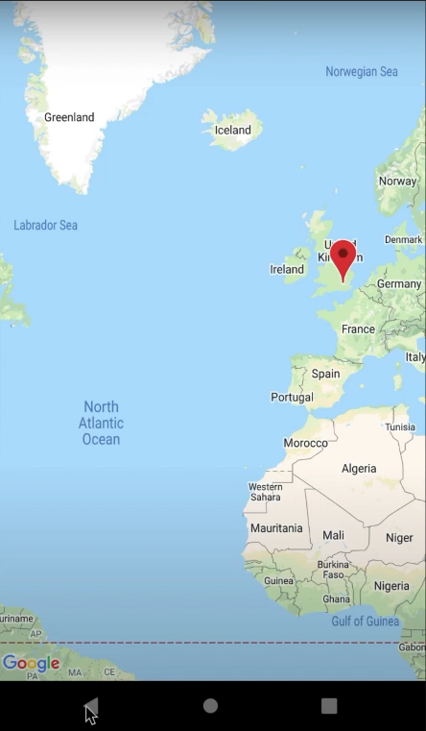
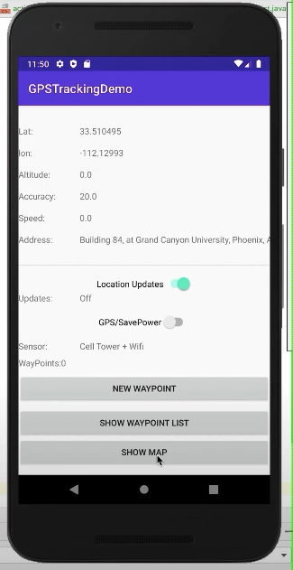
Records longitude and latitude
Used emulators to find the coarse (approximate) location and fine (exact) location
Refined app to track precise location
Accuracy measurement tool built in the app to track supplies
Low-battery Mode
Update Last-Location
Tracking

Slide 10
Records longitude and latitude
Used emulators to find the coarse (approximate) location and fine (exact) location
Refined app to track precise location
Accuracy measurement tool built in the app to track supplies

Slide 11
Ground-Based
Positioning System
new
Future Outlook
Our names are Mai Hoang, Zeel Engineer, Enlai Yii , and Briana Marcos.
12:30
Agile methodologies
Accessibility
Branch out base habitats and towers
Link networks of towers more efficiently
Include various terrains and hazards
Z-planes and 3D space (topography)
We created an app that helps rovers on Mars get to their replenishing zones before their battery runs out.
The idea is to establish stations with power and internet zones and calculate the safest, shortest path for the rover to keep going.
Battery/Energy

Slide 12
Algorithm:
Optimization
Priority Queues
Nodes and edge

